Slide 1
Front End Engineering-I Project
Team Details → Dhruv Sood – 2210090279
Dhruv Walia – 2210990280
Diksha – 2210990282
Yashika Gaur – 2210990977
Faculty Coordinator → Dr. Monika Sethi
:
Chitkara University Institute of Engineering and Technology, Chitkara University, Punjab

Slide 2

Table of Contents
Introduction
Problem Statement
Technical Details
Key Features
Project Highlights
Conclusion
References/Links used

Slide 3
Introduction
The project to be made is a SURVEY FORM.
A survey is the process of collecting, analyzing and interpreting data from many individuals.
A survey form is a digital tool used to collect information and feedback from a group of people.
This survey is designed to gather information about your recent experience shopping on Amazon.

Slide 4
Problem Statement
There is a lack of understanding or insight into the needs, preferences, and experiences of our target audience.
Without this information, it is challenging to develop products, services, and strategies that will effectively meet their needs and expectations.
As a result, we need to gather feedback and data through a survey form to gain valuable insights into our customers' thoughts, opinions, and behavior to improve our offerings and enhance our overall customer experience.

Slide 5
Technical Details
This survey form was made by using HTML, CSS & Java Script language. It was coded by using the VS Code IDE.

Slide 6
Key Features
The survey form will first ask for a details such as name, email , address and contact. It will then ask various questions ranging from the ease of use, service provided, the product quality, overall experience, as well as a dedicated text box for feedback on to make the experience even more better and easier for the users.

Slide 7
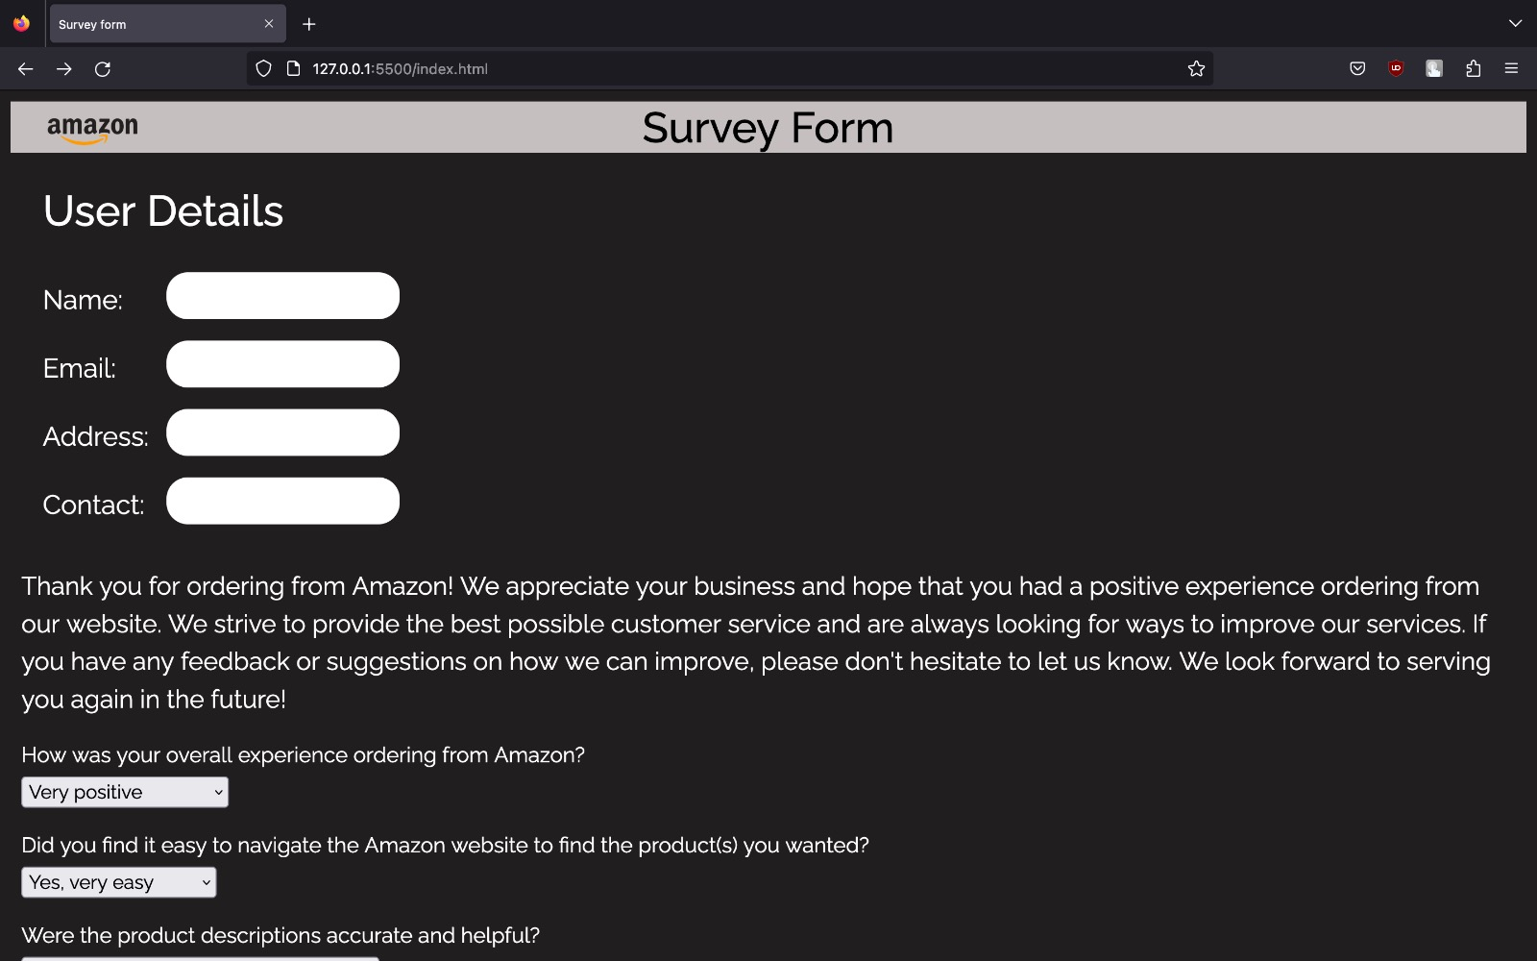
Project Highlights

Slide 8
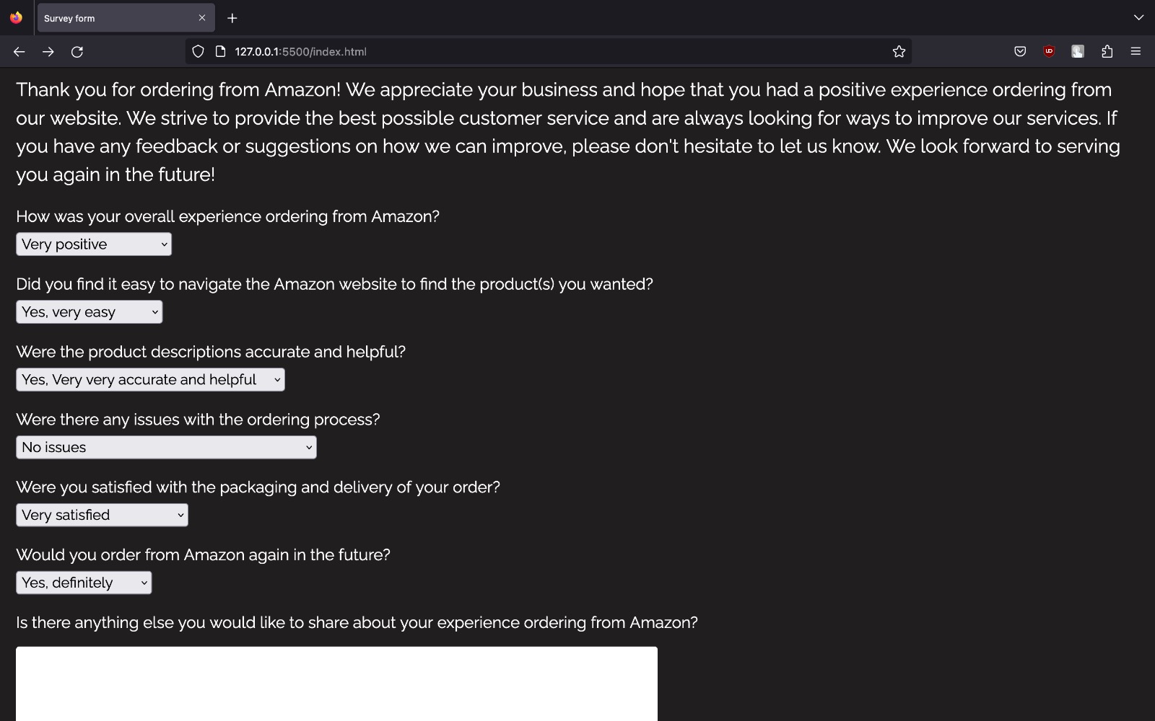
Project Highlights

Slide 9
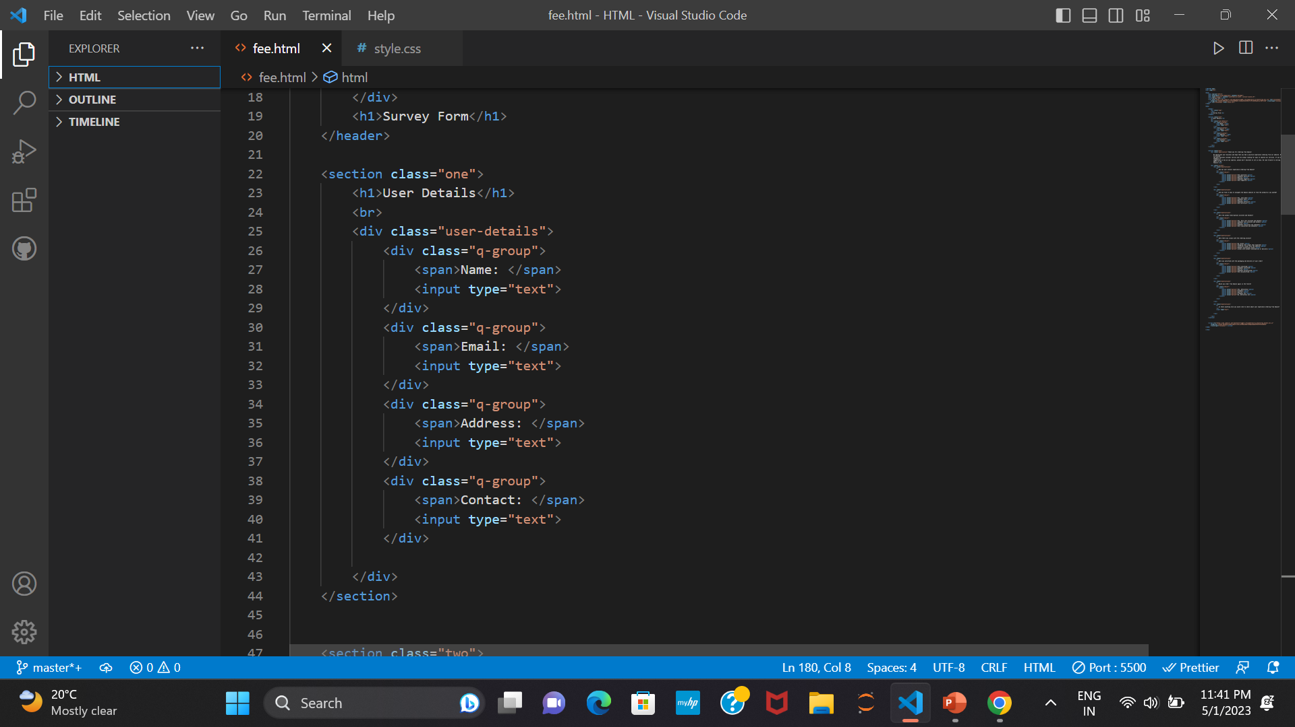
Project Highlights

Slide 10
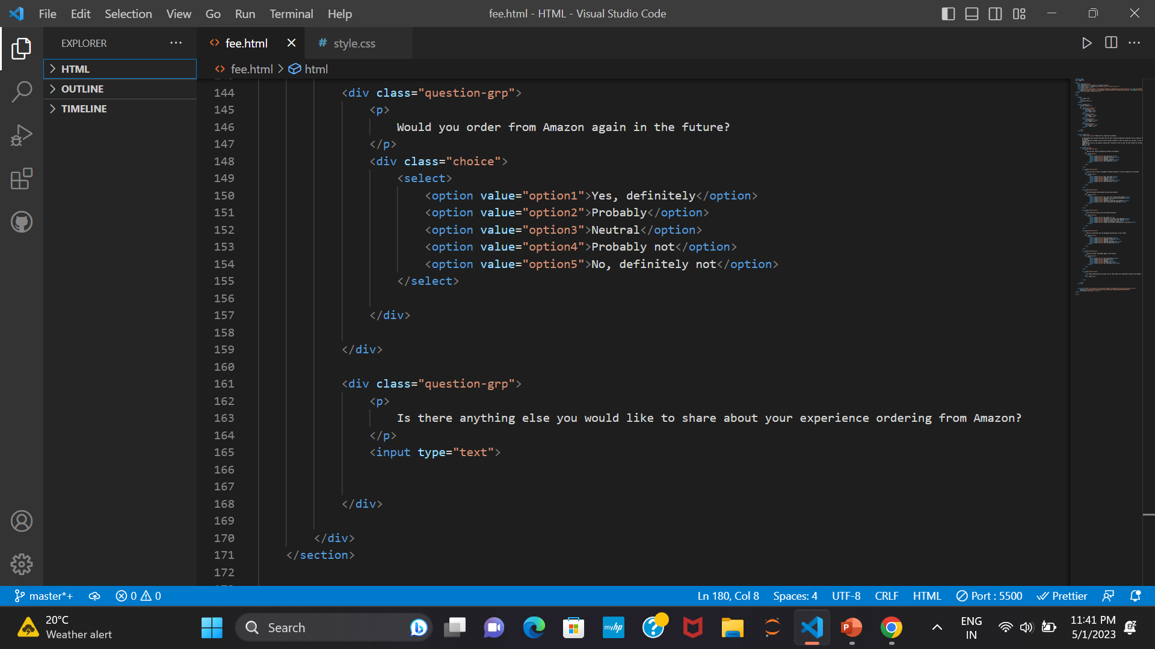

Slide 11
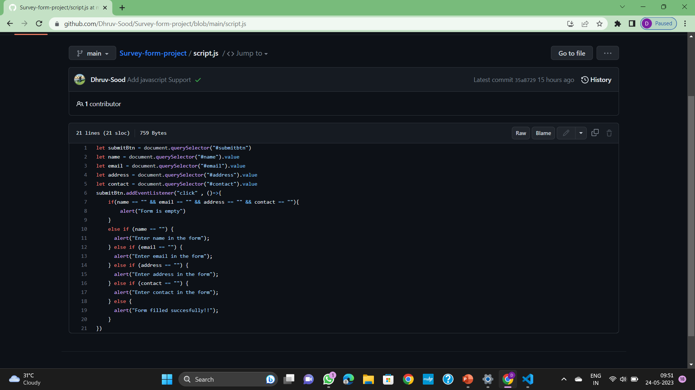

Slide 12
Conclusion
It proceeds to collect the user's information provided to it and asks various questions for the survey to complete .
The survey form design should be carefully planned to ensure that the questions are clear, relevant, and unbiased.
When creating a survey form, it is important to consider the purpose of the survey and the audience being targeted.
Our team's takeaway from this project is that it necessary to have proper survey forms for any company to succeed.

Slide 13
References/Links used
W3Schools →
For html : https://www.w3schools.com/html/
For css : https://www.w3schools.com/css/
Geeksforgeeks →
For html : https://www.geeksforgeeks.org/html/
For css → https://www.geeksforgeeks.org/css/

Slide 14


